Slide 1

Task-oriented Grasp analysis: assessment & Ranking
Internship: Technical specifications for in-hand and dexterous manipulation at the lab LASR of CEA Nano-Innov
Ricardo RICO URIBE

Slide 2
Objective
Determine the architecture for a manipulator that can perform the same or better than a human hand in the tasks of the TRACEBOT project.
Determine the best grasp possible for each task (human-oriented).
Rank the grasps with a force attribute.
Analyze each grasp for a range of available forces and directions.
Analyze each grasp for the intended movement.

Slide 3

Basic Grasp theory
The concept of grasping refers to the action of grasp (take hold) of an object, and move it, being moved by the effect of moving all the manipulator as a whole or being moved by the changes of position of each finger joint; the latter being called dexterous manipulation.
Grasping is represented trough the grasp matrix G. That relies the manipulator’s joints velocities with the object velocity.
Grasping is dependent of contact type: commonly we have Point without Friction (PwoF), Hard Finger(HF) and Soft Finger(SF). For the project we chose HF.
HF hard finger is a contact model that includes tangential friction at the contact location, this friction between the surface of the object and the finger surface allows for the transmission of the three linear components of the contact point.

Slide 4
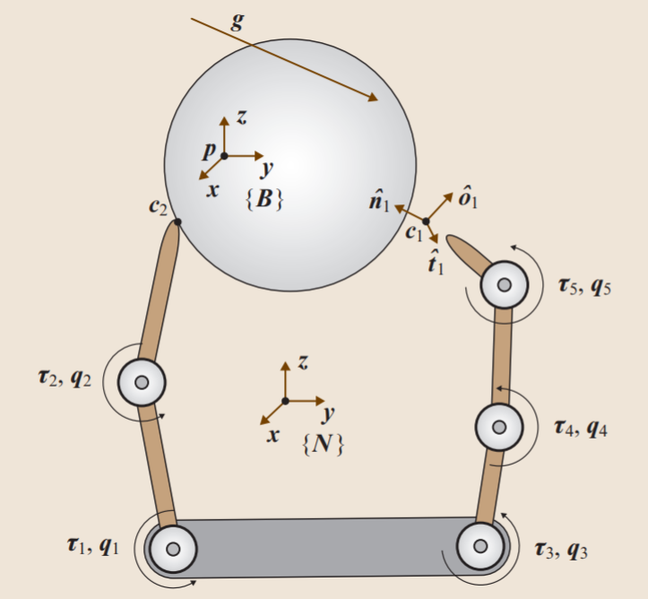
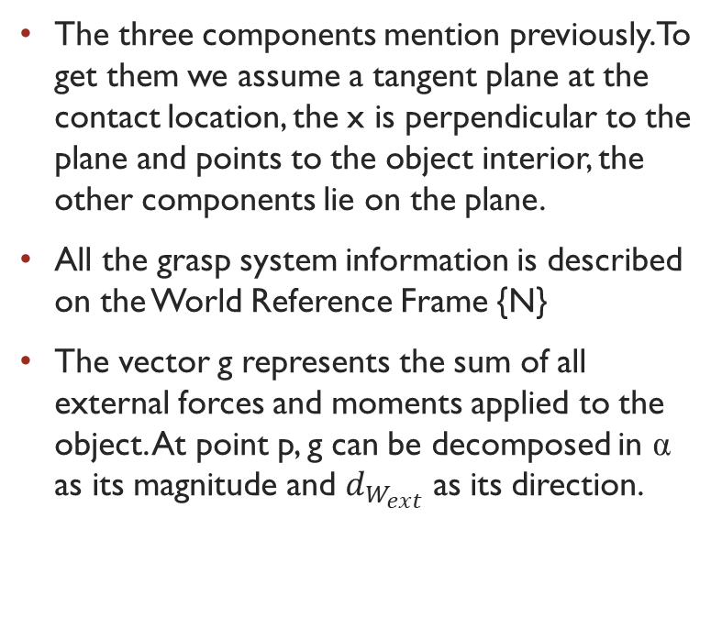
Basic grasp elements
The three components mention previously. To get them we assume a tangent plane at the contact location, the x is perpendicular to the plane and points to the object interior, the other components lie on the plane.
All the grasp system information is described on the World Reference Frame {N}
The vector g represents the sum of all external forces and moments applied to the object. At point p, g can be decomposed in α as its magnitude and $d_{W_{ext}}$ as its direction.

Slide 5
Grasp classification
Indeterminate:
A grasping system is indeterminate if N(GT) is nontrivial.
If a system is indeterminate it means that for an object with 6dof there are some velocities and moments that cannot be imprinted by the manipulator (there are internal object twists that cannot be controlled).
Graspable:
A grasping system is graspable if N(G) is nontrivial.
All internal object forces are controlled, this means that we can augment the contact forces and the object will not move but instead improve the grasp if it is based on friction.

Slide 6
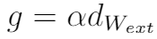
metrics used for ranking and future design
A quality metric is important because it allows us to rank and determine which grasp is better in comparison to another.
We based our metrics around the definition of g, to be able to integrate the external forces acting on the object and keep the task-oriented mentality.
We used two approaches:
With a desired direction, calculate the maximum alpha that the grasp can resist before slipping
With a known g, determine the minimum force for the actuators.

Slide 7
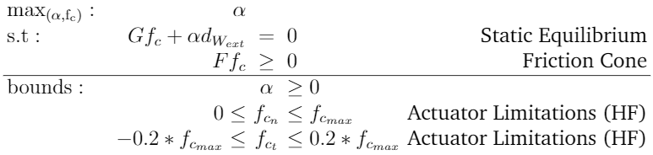
Alpha quality metric

Slide 8
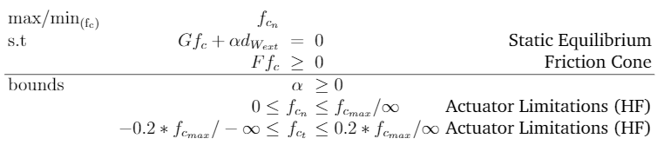
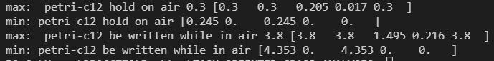
Known “G” quality metric
2 methods:
When maximizing we need to have an outer loop that increases fmax until a solution is found.
When minimizing the code is a lot quicker because we only have to run it once.

Slide 9
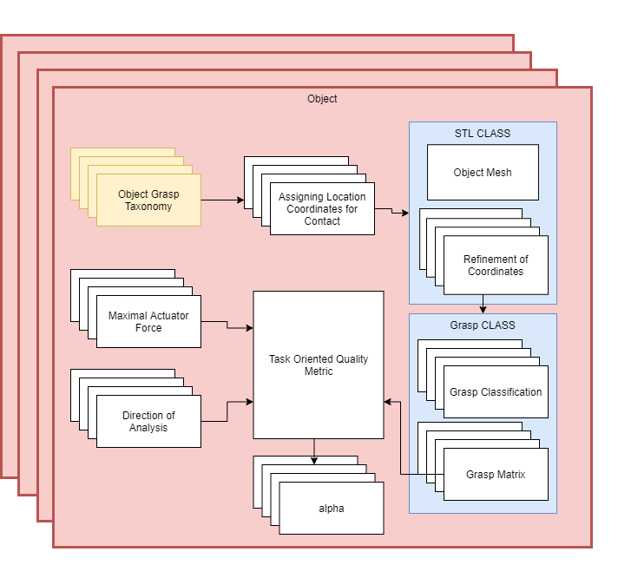
Flow to solve for alpha

Slide 10
Input information
For the Petri Dish
Grasps
"petri-c8":[[2.5,0,1.5,"e"],[2.8,1.6,0,"t"],[2.0,1.4,0,"e"],[4,1.6,0,"v"],[3.2,-.73,0,"t"],[2.3,-.73,0,"e"],[4,-0.73,0,"v"],],
"petri-c12":[[4,0,.7,'e'],[-3.5,-3.5,.7,'e'],[-4,0,.7,'e'],[-3.5,3.5,.7,'e'],[0,4,.7,'e'],],
"petri-t+1":[[2.5,0,1.5,"e"],[3.2,.73,0,"t"],[2.3,.73,0,"e"],[2.8,1.6,0,"t"],[2.0,1.4,0,"e"],[3.2,-.73,0,"t"],[2.3,-.73,0,"e"],[2.8,-1.6,0,"t"],[2.0,-1.4,0,"e"]],
"petri-t+2":[[1,-0.8,1.5,'e'],[1,0,0,'e'],[1,1,1.5,'e']],
"petri-t+3.5":[[1,-0.8,1.5,'e'],[1,0,0,'e'],[1,1,1.5,'e'],[0,0,1.5,'v'],[-1,0,1.5,'e'],[-5,0,1,'e']],
"petri-t+4":[[2.5,0,1.5,'e'],[1,1,0,'t'],[2.3,0,0,'e'],[1,-1,0,'t'],[-.5,-1,0,'t'],[0,-1,0,'e'],[1.5,4.5,0,'v'],[0,5,0,'v']],
"petri-t+5":[[4,.5,1.5,'v'],[3,.5,1.5,'t'],[4,-.5,1.5,'v'],[3,-.5,1.5,'t'],[4,-1,0,'v'],[3,-1,0,'t'],[4,1,0,'v'],[3,0,0,'t']],
Forces
"petri-hold on air":[0.000,0.000,-0.147,0,0,0],
"petri-be written while in air":[0.000,0.000,-2.612,0,0,0],

Slide 11
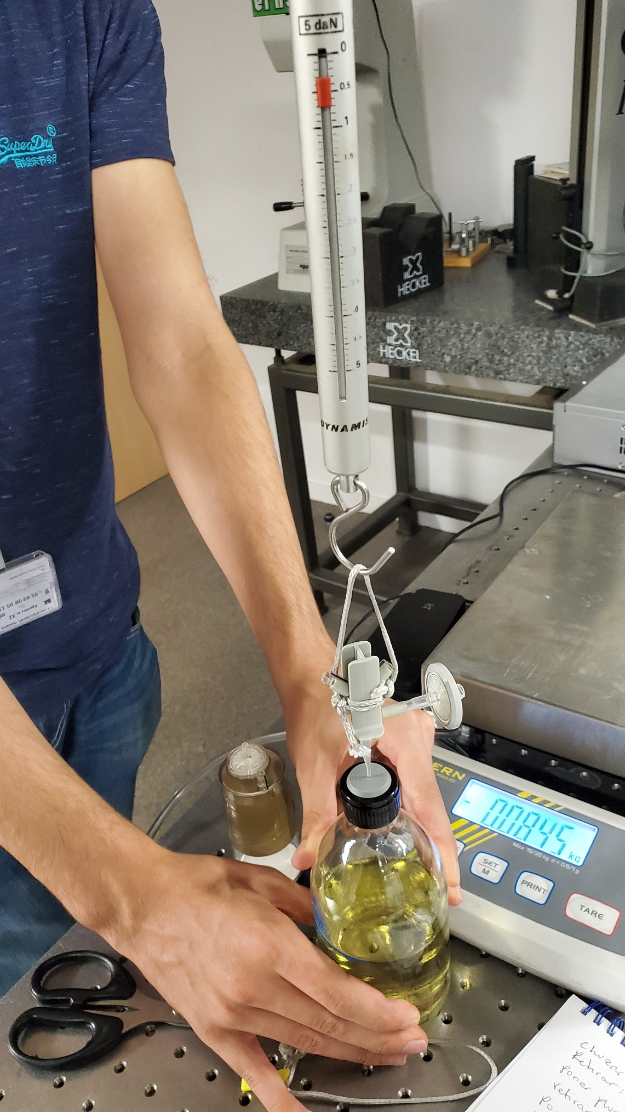
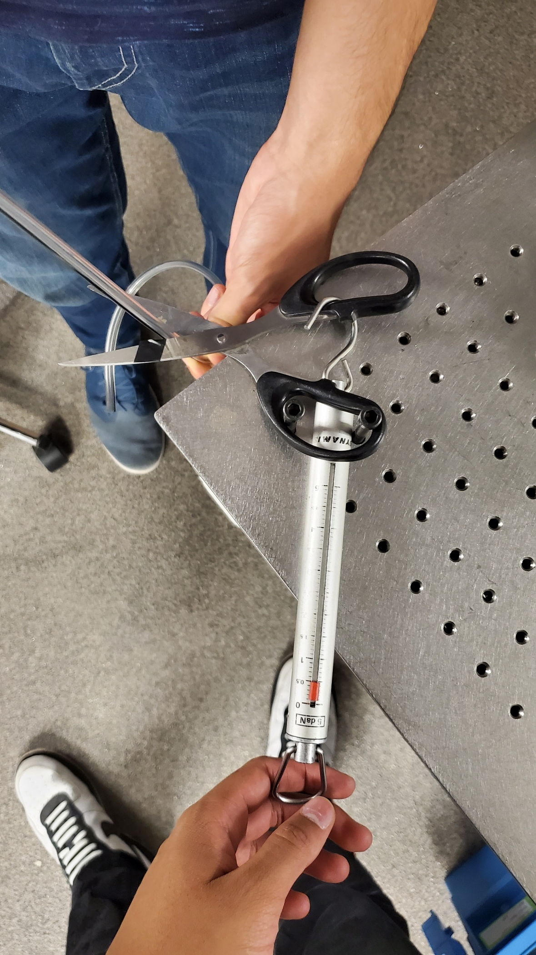
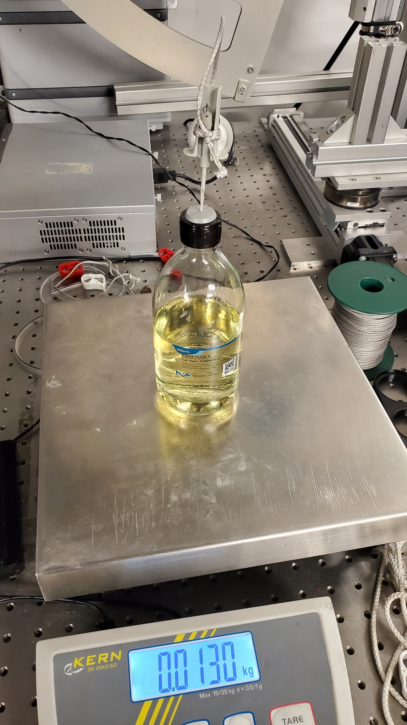
Force Data Collection

Slide 12
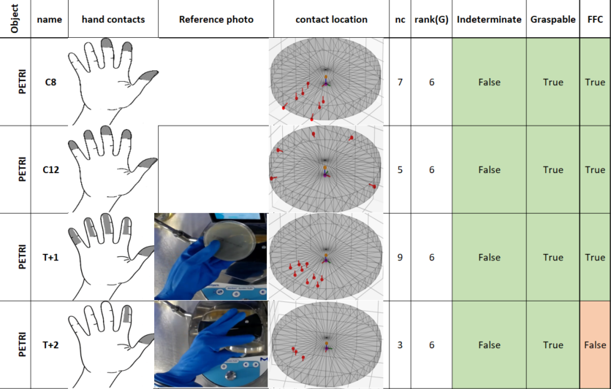
OUTPUT: GRASP Information
This table allows for the quick analysis of our grasps, if they are of the type we look for, and if they have friction form closure.

Slide 13
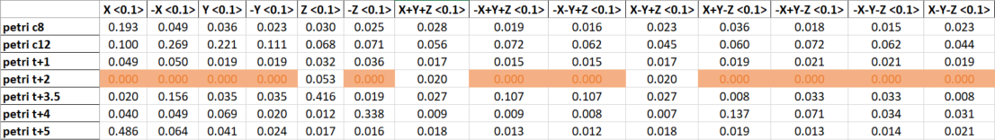
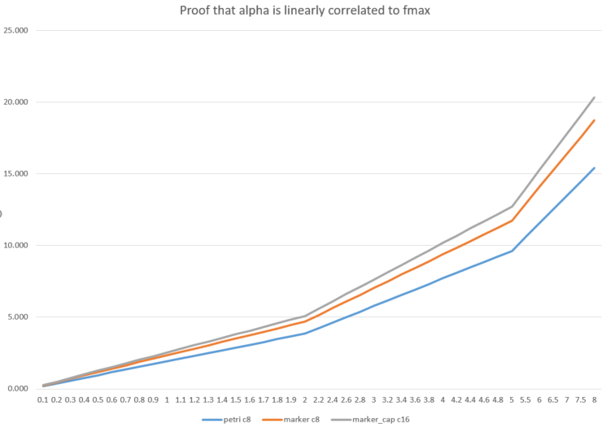
OUTPUT: RAW ALPHA
This table has the maximum force in N that the grasp resist in the corresponding direction, because is linear the growth of fmax is reflected in alpha.

Slide 14
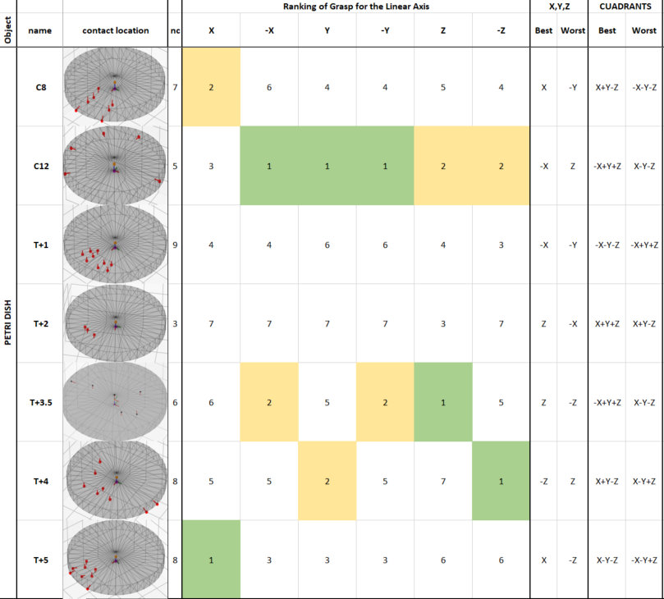
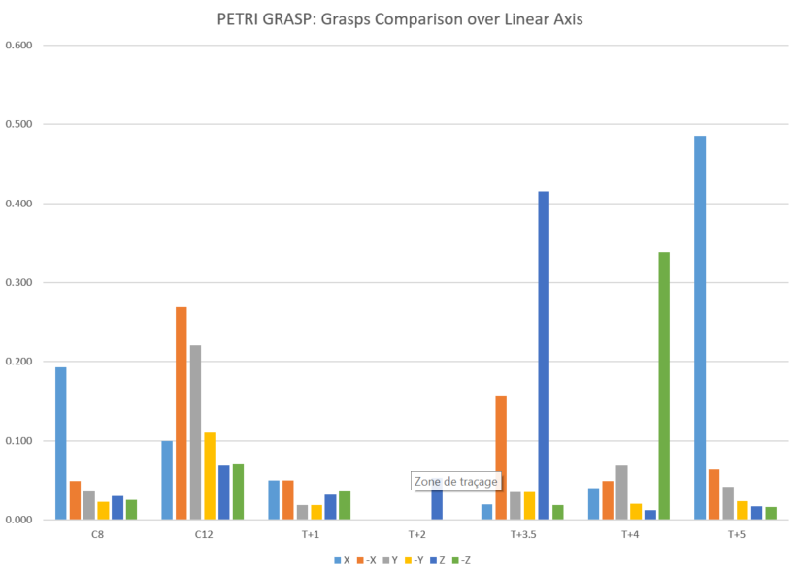
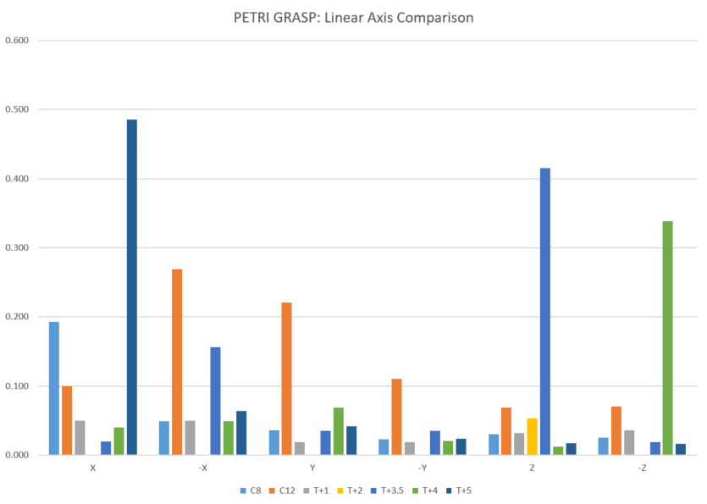
OUTPUT: Treated ALPHA

Slide 15
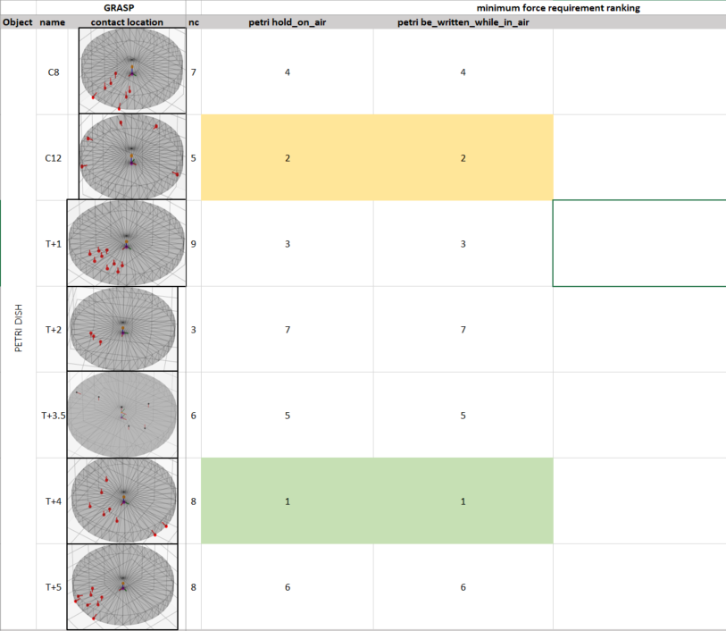
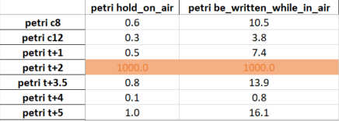
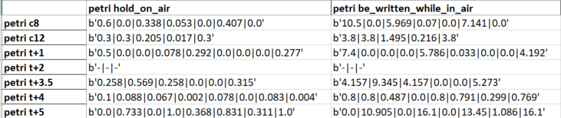
OUTPUT: FORCES
Gives the minimum force needed to perform the task (calculated with the max approach)

